Slide 1
Title of your presentation (48 pt)
Subtitlestyle, if necessary (36 pt)
Important: Please don‘t place any additional pictures on this page.
Important:
Make sure to replace or delete the secondary logo placeholder in the master slides.
Speaker: Firstname Lastname (affiliation, country)
Authors: Firstname1 Lastname1, Firstname2 Lastname2, Firstname3 Lastname3, …
Variant: Firstname1 Lastname1 et al.
August 2X, 2026 • Dresden

Slide 2

Title of your presentation (48 pt)
Subheadingstyle, if necessary (36 pt)
Remark:
You can replace the background picture with right-click → Change Picture. Remember to set the transparency to ca. 90 % so the text is still readable. Also update the image credits on the right.
Concrete wall texture; photo: kues1 via magnific.com
Speaker: Firstname Lastname (affiliation, country)
Authors: Firstname1 Lastname1, Firstname2 Lastname2, Firstname3 Lastname3, …
August 2X, 2026 • Dresden

Slide 3
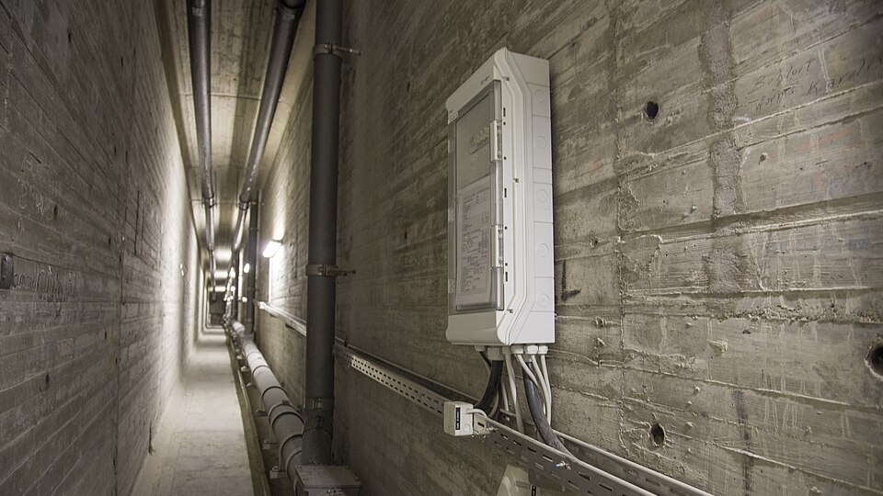
Section heading
Remark: You can replace the background picture with right-click → Change Picture. Remember to set the transparency to ca. 90 % so the text is still readable. Also update the image credits on the right.
SHM at Nibelungen Bridge; photo: Stefan Gröschel (IMB TUD)
Important: please add always a copyright if you use figures from people who are not an author. Figure title is optional
Important: To change the footer, go to View → Slide Master, then select the top master slide (the slightly bigger one) and change the footer there. Make sure to copy this text fields to all the slides, where you have placed something in front of the footer. After that, you can delete this info box.

Slide 4
Heading (36 pt semibold) • Subheading (26 pt regular)
You can use different list levels
  To increase/decrease the list level, type Alt + Shift + ←/→.
  You can emphasize something by highlighting it (gray/blue/red).
    Please don‘t use font sizes smaller than 16 pt; better is 20 pt.
    Please put quotes in italics.
    For footnotes and marginalia, you can use min 12 pt, better 14 pt, and dark-gray font color.

Slide 5
Half-sided text and info boxes
Text can be placed on a half slide using this template.
Info:
You can copy-paste this info box.
Remark:
Use this to emphasize something.
Important:
With red boxes you can highlight something very important.

Slide 6
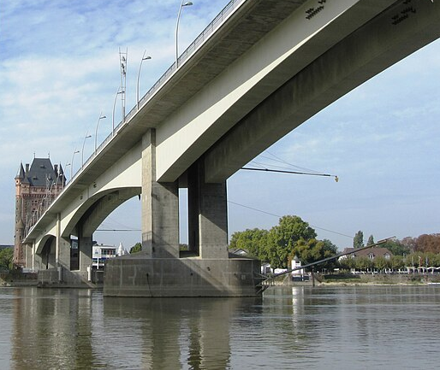
Pictures
Feel free to add pictures
to your slides.
Photo: Nibelungen Bridge, Pratz53 via Wikimedia Commons

Slide 7
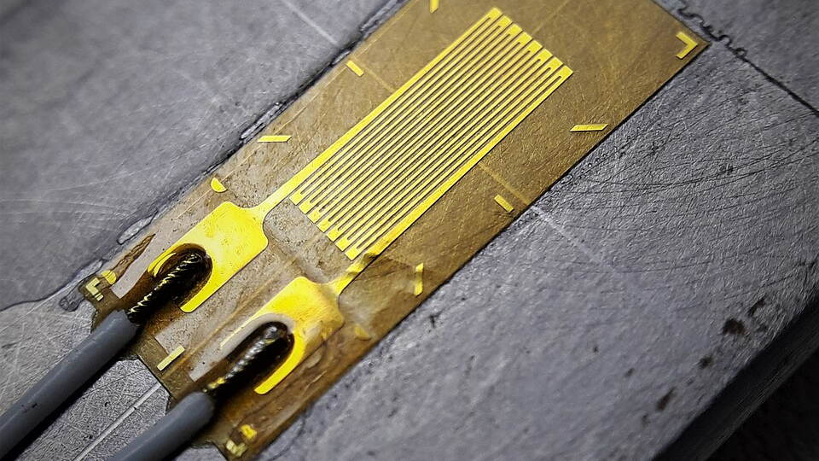
Pictures • Full screen
If you place full screen pictures in the background, please make sure to set the image transparency to ca. 90 % so the content is still readable.
Strain gauge: photo: Cristian V. via Wikimedia Commons

Slide 8

Font installation
To install the font used in this template (Noto Sans), please follow these steps:
  Download the font here (Get font → Download all)
  Unzip the file and double-click on both NotoSans-… .ttf files, then click Install to install the fonts.
Remark:
As a fallback option, you can use Trebuchet MS
(preinstalled on Windows and Mac):
“Test Text in Trebuchet MS”

Slide 9


Contact (optional!)
Remark:
Optionally create a VCard with this data-friendly tool or link your website using this data-friendly tool.
Remark:
Right-click → replace image
firstname.lastname@example.com

